Slide 1
A Two-stage Classifier for Protein β-turn Prediction Using Support Vector Machines
Hua-Sheng Chiu, Hsin-Nan Lin, Allan Lo, Ting-Yi Sung and Wen-Lian Hsu
Bioinformatics Lab., Institute of Information. formation Science, Academia Sinica, Nankang, Taipei, 115, Taiwan
Proceedings of IEEE International Conference on Granular Computing (IEEE GrC), USA, May 10-12, 2006.
Speaker: Hsin-Wei Yen
Date: Sept. 24, 2008

Slide 2
Abstract
β-turns play an important role in protein structures not only because of their sheer abundance, which is estimated to be approximately 25% of all protein residues, but also because of their significance in high-order structures of proteins. In this study, we introduce a new method of β-turn prediction that uses a two-stage classification scheme and an integrated framework for input features.

Slide 3
Abstract (cont’)
Ten-fold cross validation based on a benchmark dataset of 426 non-homologue protein chains is used to evaluate our method’s performance. The experimental results demonstrate that it achieves substantial improvements over BetaTurn, the current best method. The prediction accuracy, Q_{tatal}, and the Matthews correlation coefficient (MCC) of our approach are 79% and 0.47 respectively, compared to 77% and 0.45 respectively for BetaTurn.

Slide 4
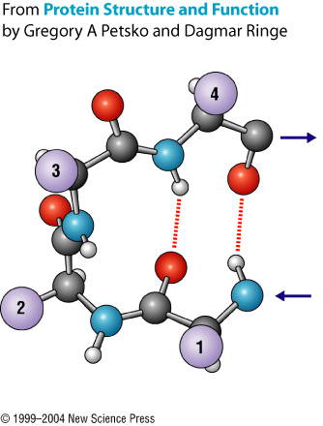
β-turn
Shorter distance between C_{α}(i) and C_{α}(i+3),

Slide 5

Super-secondary Structure:β-hairpins

Slide 6
Dataset
426 non-homologous protein chains
Determined by X-ray crystallography
Identity of any pair of protein chains is no more than 25%
The secondary structures of each protein chain are assigned by DSSP

Slide 7
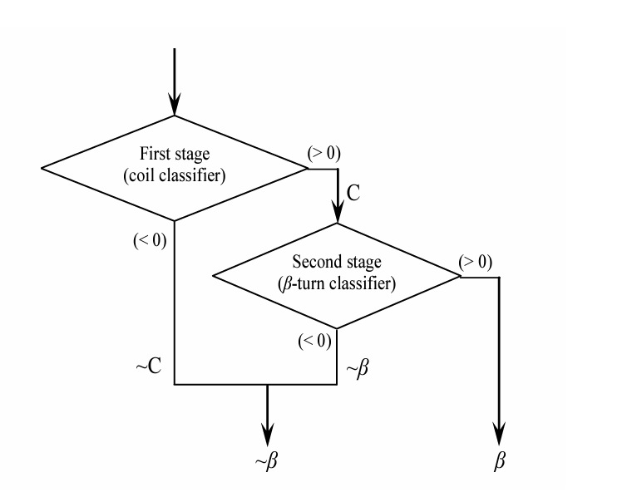
Two-stage Classifier

Slide 8
First Stage
SVM_TREE1
SVM_TREE2
SVM_TREE3
SVM_MAX_D
SVM_VOTE

Slide 9
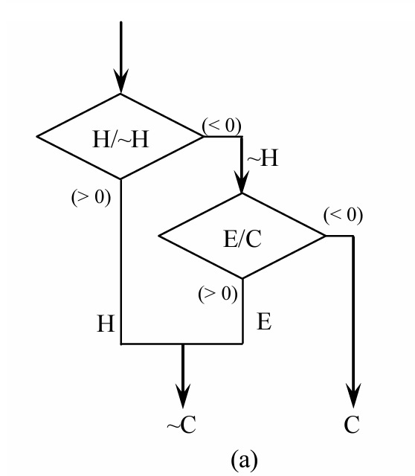
First Stage
SVM_TREE1
SVM_TREE2
SVM_TREE3
SVM_MAX_D
SVM_VOTE

Slide 10
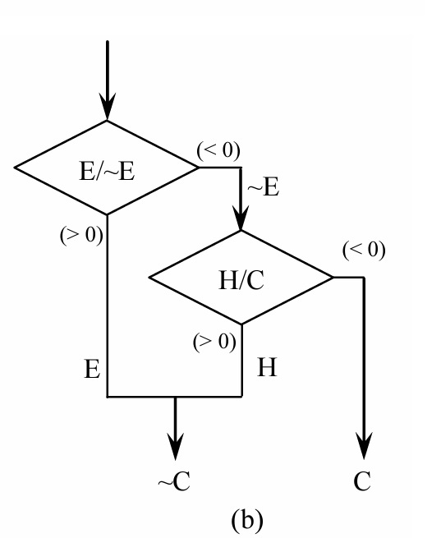
First Stage
SVM_TREE1
SVM_TREE2
SVM_TREE3
SVM_MAX_D
SVM_VOTE

Slide 11
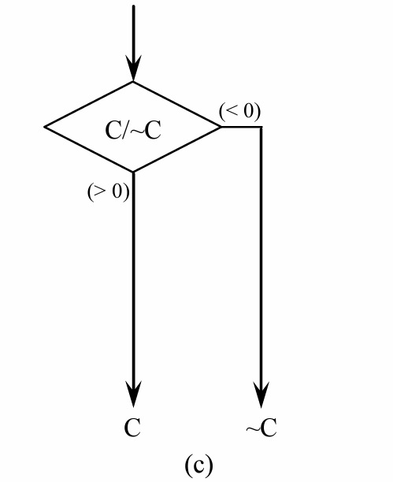
First Stage
SVM_TREE1
SVM_TREE2
SVM_TREE3
SVM_MAX_D
SVM_VOTE

Slide 12
First Stage
SVM_TREE1
SVM_TREE2
SVM_TREE3
SVM_MAX_D
SVM_VOTE

Slide 13
Feature Representation
AA (amino acid composition)
PSSM (position-specific scoring matrices)
SSE (secondary structure elements) from HYPROSP II
20 x w₁
( 20 + 20 + 3 ) x w₂
AA
AA
PSSM
SSE

Slide 14
Training and Testing
Train the classifiers with the LIBSVM
The radial basis function (RBF) is selected as the kernel function
Ten-fold cross validation is used to evaluate the proposed method
  9 training
  1 testing

Slide 15
Filtering: State-flipping
1) change an isolated non-turn prediction to a turn
  i.e. t-t => ttt
2) change an isolated pair of turn prediction to a non-turn
  i.e. -t- => ---

Slide 16
Filtering: State-flipping (cont’)
3) change an isolated pair of turn predictions to non-turns
  i.e. -tt- => ----
4) change a non-turn prediction adjacent to three turn predictions to a turn
  i.e. -ttt- => tttt- or -tttt

Slide 17
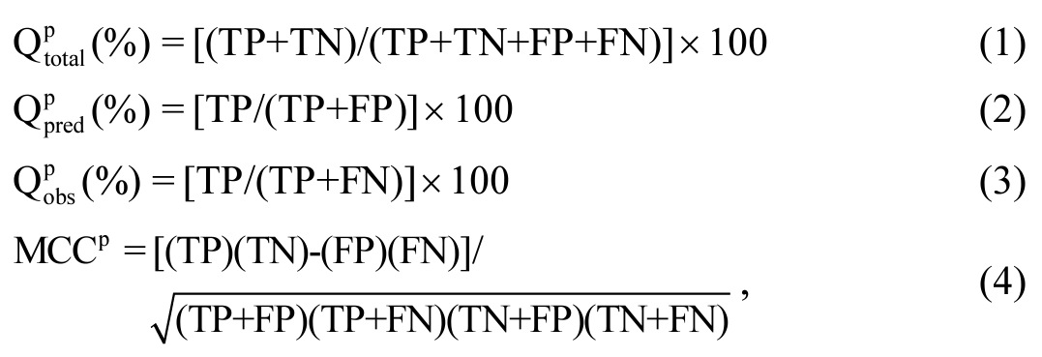
Performance Measures

Slide 18
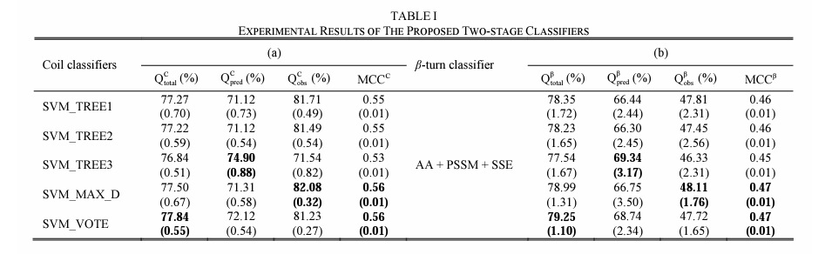
Results (1/3)

Slide 19
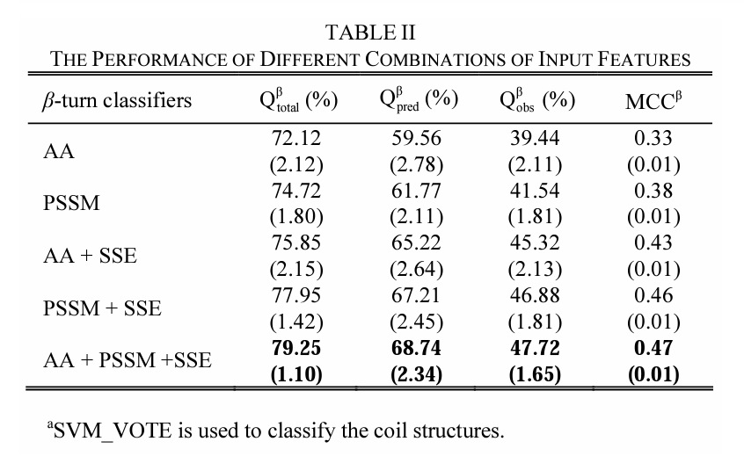
Results (2/3)

Slide 20
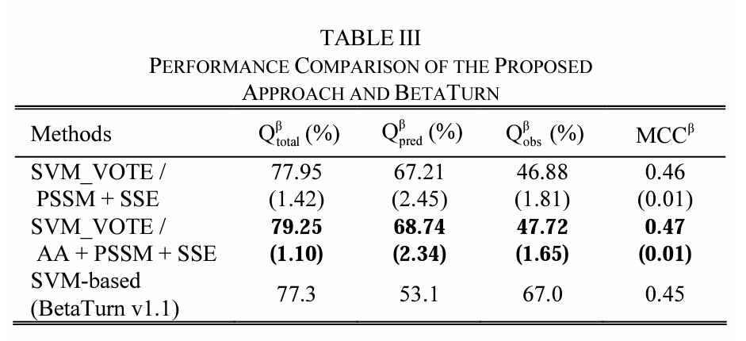
Results (3/3)

